Slide 1
ParlaMint Corpora
Comparable and Interoperable Corpora of Parliamentary Debates
Tomaž Erjavec,
Jožef Stefan Institute
March 25, 2024 | Fred Jelinek seminar series, Prague (Zoom)

Slide 2
Parliamentary corpora
Important text type: what is said in parliament has consequences
Interesting for political science, sociolinguistics, historical studies, citizen science, etc.
Easy to get (published on the Web)
Easy to disseminate (no copyright, no privacy protection)
However, most such corpora cover only one or a few parliaments
So, no inter-country comparison possible
It would be nice if there existed a uniformly encoded set of all European parliamentary corpora

Slide 3
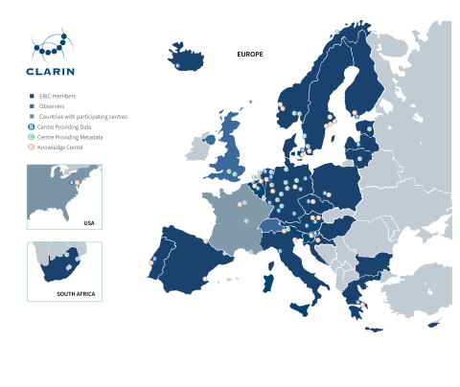
What is CLARIN?
CLARIN is a digital infrastructure offering data, tools and services to support research based on language resources
A distributed network of 70 centres with 24 member countries and 2 observers

Slide 4
What is ParlaMint?
CLARIN flagship projects:
ParlaMint I (2020–2021)
ParlaMint II (2022-2023)
Main deliverable:
uniformly encoded transcriptions of speeches from European parliaments
covering at least 2015–2021 (ParlaMint II: 2022)
rich metadata
linguistically annotated
openly available

Slide 5
ParlaMint I (2020-2021)
Compiled 17 corpora, each compiled by the partner from that country
Available for download in CLARIN.SI repository and for analysis in CLARIN.SI noSketch Engine
Described in: Tomaž Erjavec, Maciej Ogrodniczuk, Petya Osenova, Nikola Ljubešić, Kiril Simov, Andrej Pančur, Michał Rudolf, Matyáš Kopp, Starkaður Barkarson, Steinþór Steingrímsson, Çağrı Çöltekin, Jesse de Does, Katrien Depuydt, Tommaso Agnoloni, Giulia Venturi, María Calzada Pérez, Luciana D. de Macedo, Costanza Navarretta, Giancarlo Luxardo, Matthew Coole, Paul Rayson, Vaidas Morkevičius, Tomas Krilavičius, Roberts Darǵis, Orsolya Ring, Ruben van Heusden, Maarten Marx & Darja Fišer. The ParlaMint corpora of parliamentary proceedings. Language Resources & Evaluation 57:415–448 (2023). 10.1007/s10579-021-09574-0.

Slide 6
ParlaMint II (2022 - 2023)
WP1: Documentation, interoperability, metadata (Lead: Tomaž Erjavec (IJS), Matyáš Kopp (UFAL))
T1.1: Harmonization of encoding, T1.2: Git management, T1.3 Adding metadata to existing corpora
WP2: Corpus expansion (Lead: Tomaž Erjavec (IJS))
T2.1: Adding new corpora, T2.2: Extending existing corpora, T2.3: Data distribution
WP3: Corpus enrichment (Lead: Nikola Ljubešić (IJS) // Taja Kuzman (IJS), Paul Rayson (UCREL))
T3.1: Machine translation and semantic tagging, T.3.2: Multimodality
WP4: Engagement activities (Lead: Darja Fišer (INZ), Cagri Coltekin (TUB))
T4.1: Tutorial, T4.2: Hackathon, T4.3: Shared task, T4.4: Showcases
WP5: Coordination (Lead: Maciej Ogrodniczuk (IPI-PAN), Petya Osenova (IICT-BAS))
T5.1: Management, T5.2: Dissemination, T5.3: External monitoring

Slide 7
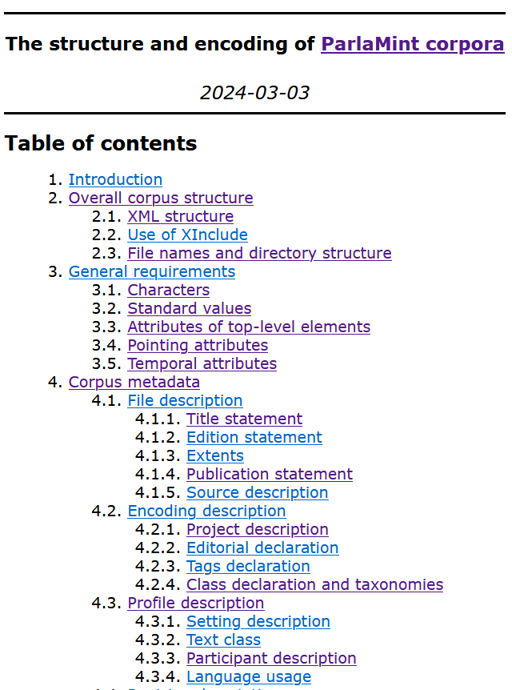
Task 1.1: Harmonization of encoding
Basis: Text Encoding Initiative Guidelines
CLARIN ParlaFormat workshop 2019, Amersfoort (T.Erjavec and A.Pančur)
Parla-CLARIN: a TEI customisation for corpora of parliamentary proceedings
ParlaMint I: special schemas
ParlaMint II: ParlaMint TEI customisation
TEI ODD document with:
schema specification
encoding guidelines
During ParlaMint II many additions and modifications to the schema
ParlaMint schema uses 111 TEI elements

Slide 8
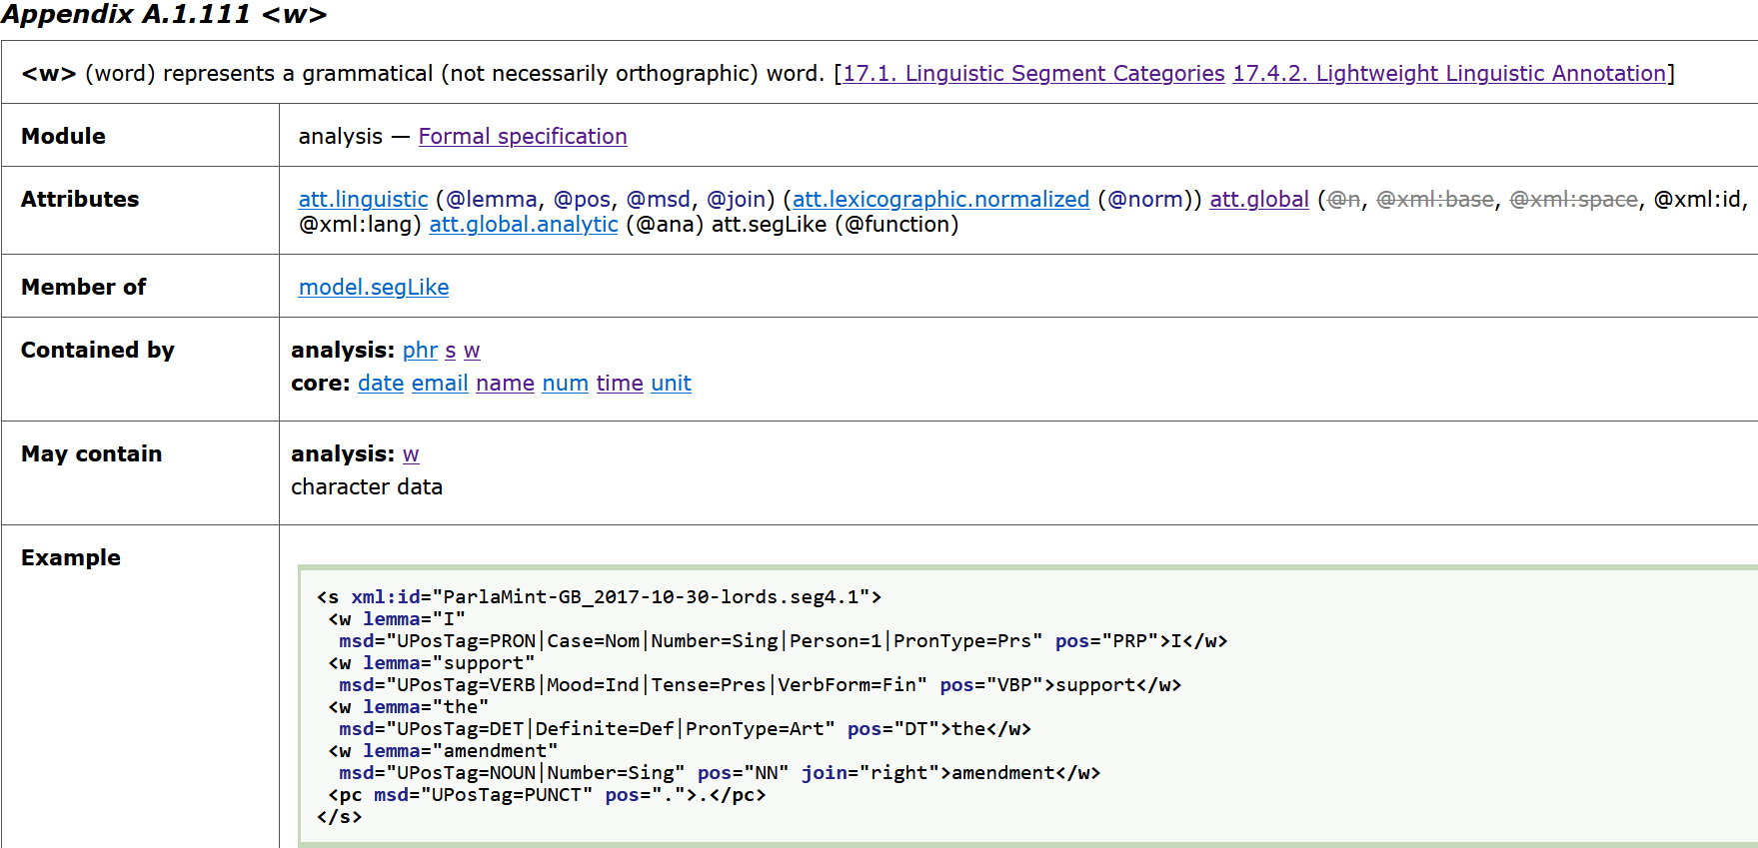
Element documentation

Slide 9
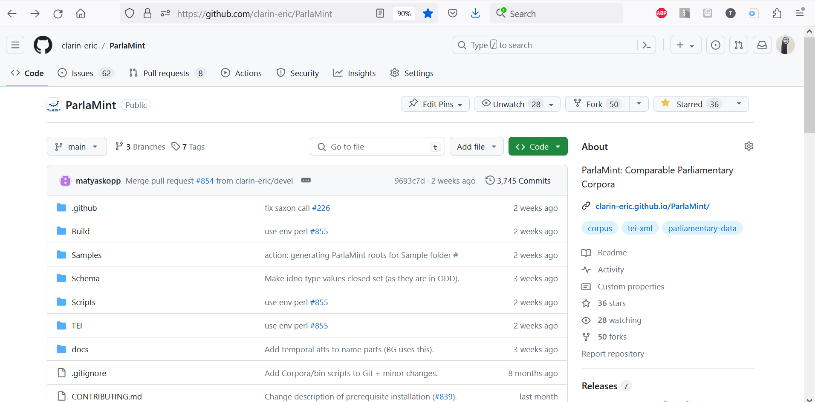
Task 1.2 :Git Management
https://github.com/clarin-eric/ParlaMint
Everything except complete corpora is on GitHub
GitHub Issues: main communication channel in ParlaMint II
GitHub Pages: encoding guidelines
GitHub Actions: validation of corpus samples

Slide 10
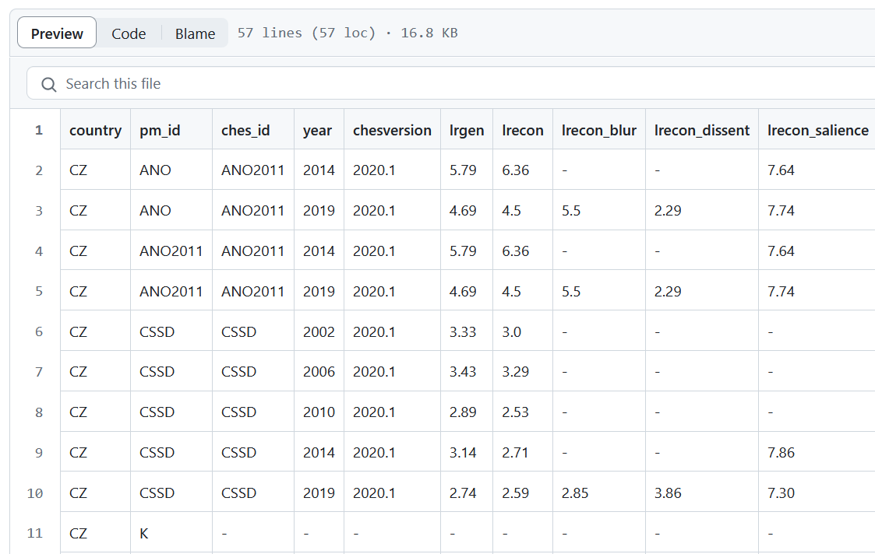
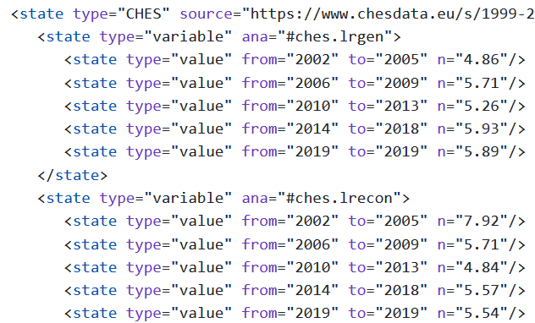
Task 1.3: Adding metadata
Added localisation (multilingual taxonomies), ministers, L-R political orientation from Wikipedia, CHES political orientation variables
Implemented merging TSV files into XML corpora
⇒

Slide 11
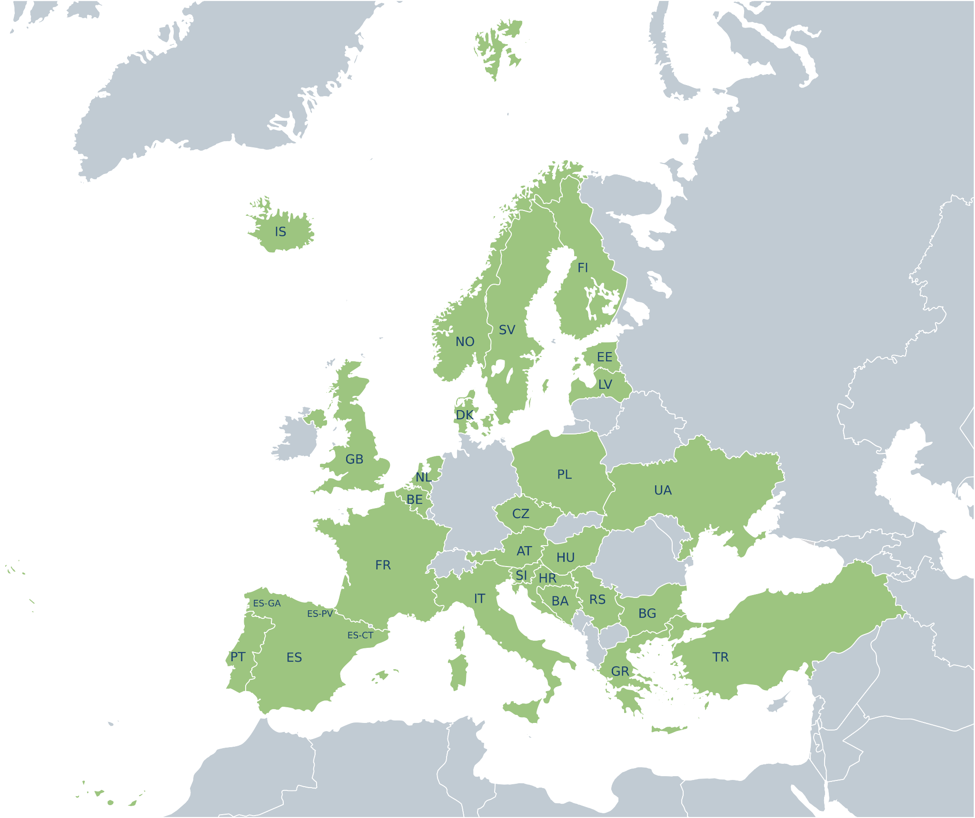
Task 2.1: Adding new corpora (17 + 12 = 29 countries and autonomous regions)
Austria
Basque Country
Bosnia and Herzegovina
Belgium
Bulgaria
Catalonia
Croatia
Czech Republic
Denmark
Estonia
Finland
France
Galicia
Greece
Hungary
Iceland
Italy
Latvia
Netherlands
Norway
Poland
Portugal
Serbia
Slovenia
Spain
Sweden
Turkey
UK
Ukraine

Slide 12
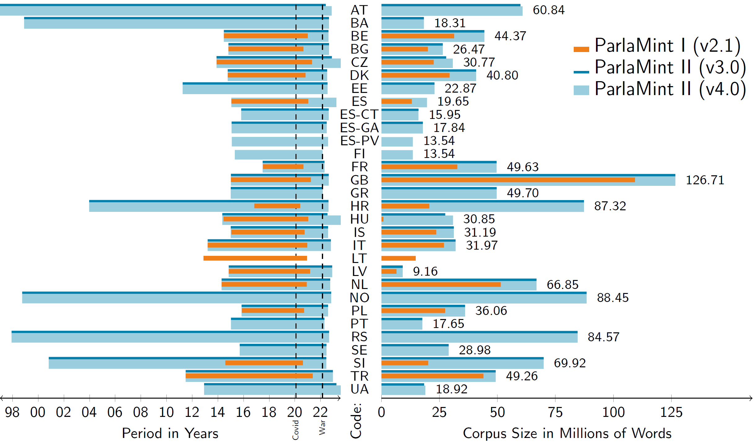
Task 2.2: Extending existing corpora

Slide 13
Preparing the corpora by partners
Each partner prepared their own corpus
Including linguistic annotation:
tokenisation and sentence segmentation
lemmatisation
Universal Dependencies morphological features
Universal Dependencies syntax
Named Entities (4 class)
Many different tools were used for linguistic annotation, the most popular were:
UDPipe (8 corpora)
UDPipe 2 (LINDAT web service): AT, CZ, ES, ES-CA, ES-PV, UA
CLASSLA-Stanza (5 corpora)
Stanza (4 corpora)
NameTag (4 corpora)
NameTag 2 (LINDAT web service): AT, CZ, ES, UA

Slide 14
Validation and deployment
Validation was taken very seriously:
against ParlaMint RelaxNG schemas
against ParlaMint ODD schema
XSLT script for content validation
down-conversion releveals errors
using the corpus reveals further errors
Deployment pipeline:
adding TSV metadata
fixing noted but uncorrected mistakes
adding common metadata (e.g. titles, extents, tag-usage)
validation
down-conversion (txt, TSV metadata, CoNLL-U, vertical)
packing for a release

Slide 15
Task 2.3: Data distribution
Download 4.0 (CC BY) from the CLARIN.SI repository:
TEI “plain text” format
with added linguistic annotation
translated into English
samples and environment: ParlaMint GitHub
Analysis in the following tools:
noSketchEngine without login and with login
KonText (CNC version of noSkE)
TEITOK (Maarten Janssen @ UFAL)

Slide 16
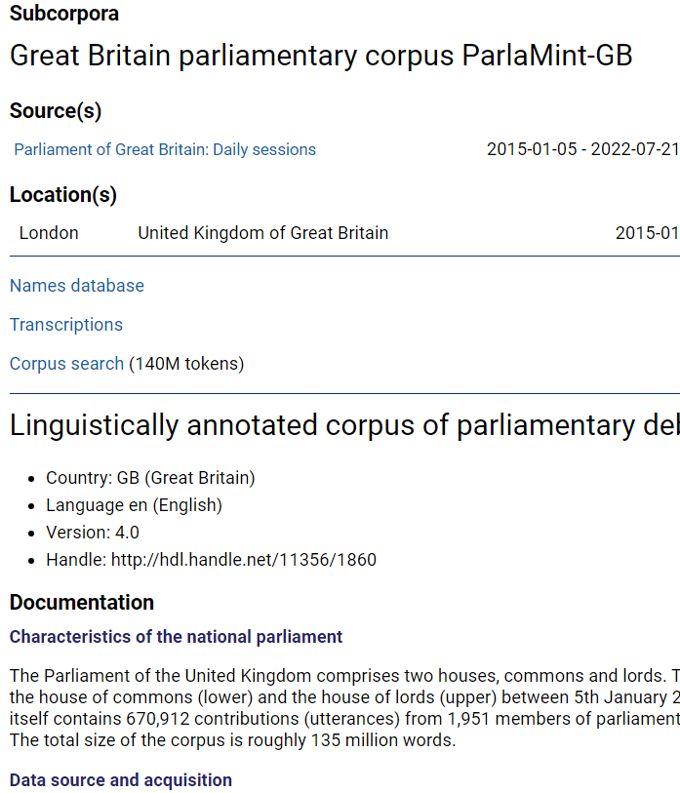
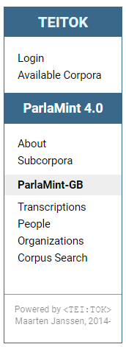
TEITOK

Slide 17
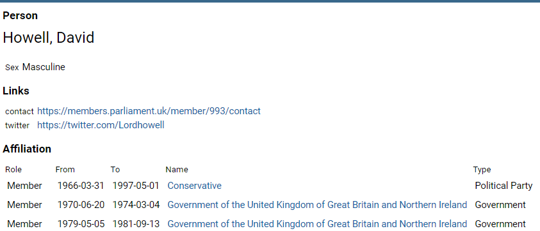
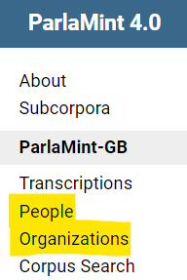
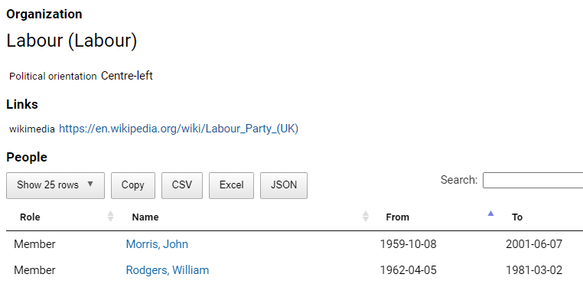
TEITOK

Slide 18
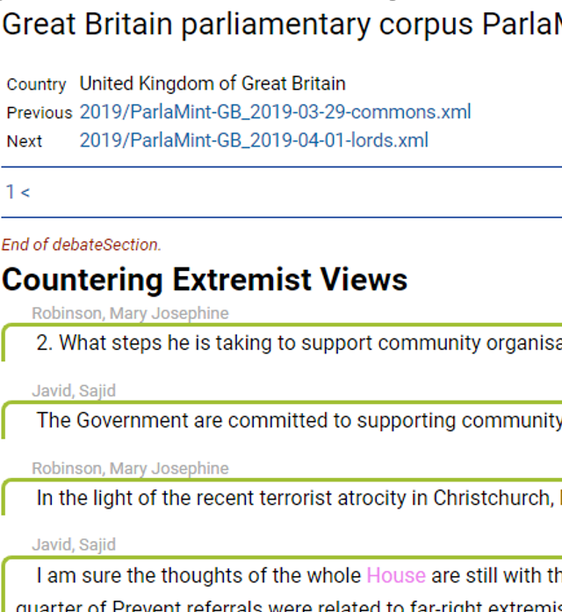
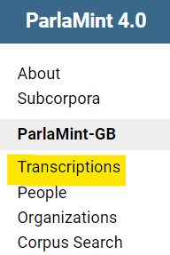
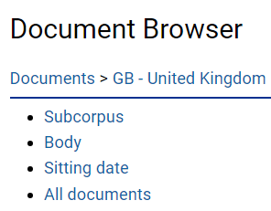
TEITOK

Slide 19
Task 3.1: Machine translation and semantic tagging
pre-trained OPUS-MT models
cover all ParlaMint languages
post-processing to correct translations of proper names
English has typical NMT errors, including factual errors!
annotation with USAS semantic tags on words, partially on phrases

Slide 20
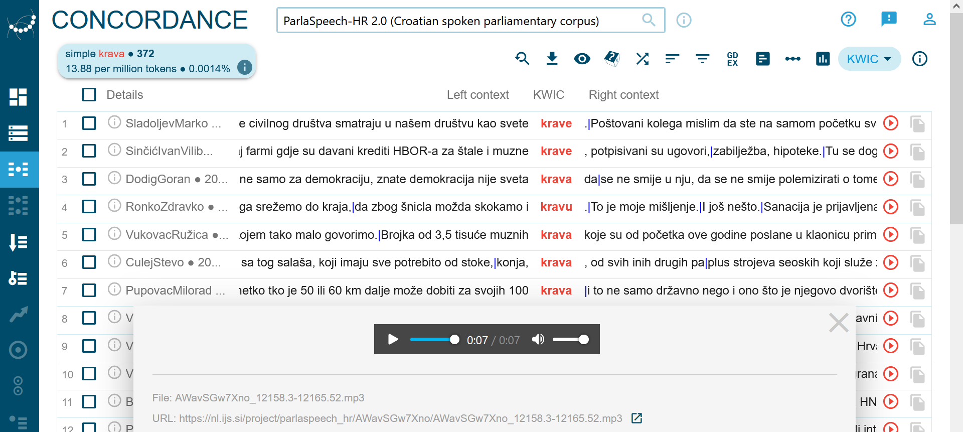
Task 3.2: Multimodality Four pilot speech corpora:
Complicated:
transcripts have different order from recordings
not all recordings are transcribed or made public
transcripts only vaguely correspond to the speeches
thousands of hours of recordings and tens of millions of words of transcripts

Slide 21
Work Package 4: Engagement activities
Tutorials on usage of ParlaMint corpora:
Digital Humanities conference 2023, Graz
European Summer University in Digital Humanities 2023
ParlaMint tasks in the scope of Helsinki Digital Humanities
Hackathons:
Networks of power: Gender analysis in selected European parliaments (2022)
Splitting lips: polarization through parliamentary speech.(2023)
Echoes of the Chambers: Studying Democracy through Parliamentary Speeches (2024)
Shared task using ParlaMint corpora to be held at CLEF 2024:
Ideology and Power Identification in Parliamentary Debates

Slide 22
Current work
Working on V4.1
maintenance release
UA extended to 2023
probably released in May
Submitting LREV paper:

Slide 23
Future directions
Write a “How to make your own ParlaMint corpus” tutorial
Extending country and time coverage?
ParlaMint Light corpora?
More metadata (e.g. V-dem)?
Linking to other types of documents (e.g. laws, party manifestos)
Centralising and automating corpus construction:
supervised machine learning: source HTML + ParlaMint corpora

Slide 24
DH Awards Nomination
ParlaMint has been nominated for the DH Awards in the Best DH Dataset category http://dhawards.org/dhawards2023/voting/
You can vote until 30 March 2024

Slide 25
Thank you – and see you at
https://www.clarin.eu/parlamint

