Slide 1
Standardising annotation of language data: TEI
Tomaž Erjavec
Department of Knowledge Technologies, Jožef Stefan Institute
FRI, 29th April, 2020

Slide 2
Overview of the lecture
Introduction
History, organisation and scope of TEI
TEI modules
TEI in Slovenia

Slide 3
Text Encoding: Representing Research Objects
Overview of Text Encoding and the TEI, slide 1 of 6 © 2014 Syd Bauman, Julia Flanders, and WWP .(CC BY-SA 3.0)
https://www.wwp.northeastern.edu/outreach/seminars/context_2011-09/presentations/overview/overview_new_01.xhtml

Slide 4
Digital formats for text
Graphic formats (facsimile of text)
Sound formats (speech)
Video formats (movie of a speaker)
Tabular formats (lexicons, some training sets)
XML (annotated text and pointers)

Slide 5
Advantages of XML
Supports hierarchical structures and pointers
Allows mixing text and annotations
A W3C standard
Formal validation via a schema: DTD, W3C schema, RelaxNG, Schematron
Many associated standards: XInclude, XPath, XSLT, Xquery
Tool support: Saxon (XSLT), eXist (XQuery), editors (Oxygen, emacs)
“Simple” conversion to applications formats: XML, HTML, JSON, tables, PDF, …
A good archive format

Slide 6
XML schemas for text annotation
XML is a meta-language: it is the schema defines the allowed elements and attributes, and allowed nestings
In addition to the formal schema (syntax) we also need documentation of the meaning of the elements, attributes, values (semantics)
We can develop a schema for a particular type of documents ourselves
For data interchange (and tool support) it is better to use a standard schema
For linguistic annotation there are (too) many standard and best-practice schemas:
ISO TC 37 SC4 standards for encoding language resources
National projects (TCF: Germany, FoLiA: Netherlands, …)
and TEI, which is, however, much broader

Slide 7
Text Encoding Initiative
Started as a research project in the humanities
supported by three professional associations
financed 1990-1994 (ZDA, EU)
influential text types:
digital libraries, text collections
language corpora
scholarly datasets
International consortium established 1999
Web page: http://www.tei-c.org/

Slide 8
Goals of the TEI
Better interchange and integration of scholarly data
Support for all texts, in all languages, from all periods
Guidance for the perplexed: what to encode: a user-driven codification of existing best practice
Assistance for the specialist: how to encode: a loose framework into which unpredictable extensions can be fitted
These apparently incompatible goals result in a highly flexible, modular, environment

Slide 9
Legacy of the TEI
A way of looking at what ‘text’ really is
A codification of current scholarly practice
A set of shared assumptions and priorities about the digital agenda:
focus on content and function (rather than presentation)
identify generic solutions (rather than application-specific ones)

Slide 10
TEI Guidelines
“TEI Guidelines for Electronic Text Encoding and Interchange” cf. http://www.tei-c.org/Guidelines/
Cover generic structures as well as very specific fields
A large collection of XML element and attribute definitions
TEI Guidelines comprise documentation and formal definitions Written in TEI ODD: One Document Does it all
In print ~1.200 pages
A modular system for creating personalized schemas
Maintained on GitHub, available in TEI/XML, HTML, PDF, EPUB,…

Slide 11
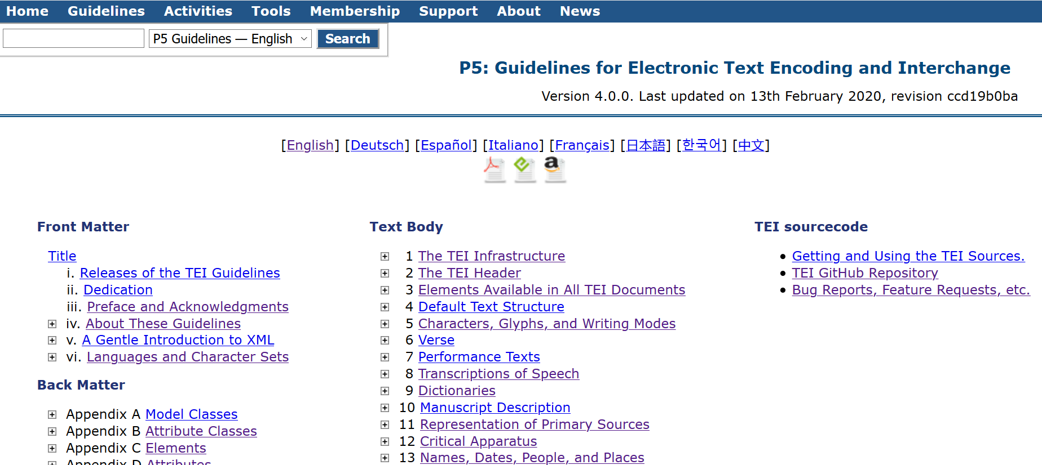
TEI Guidelines on the Web

Slide 12
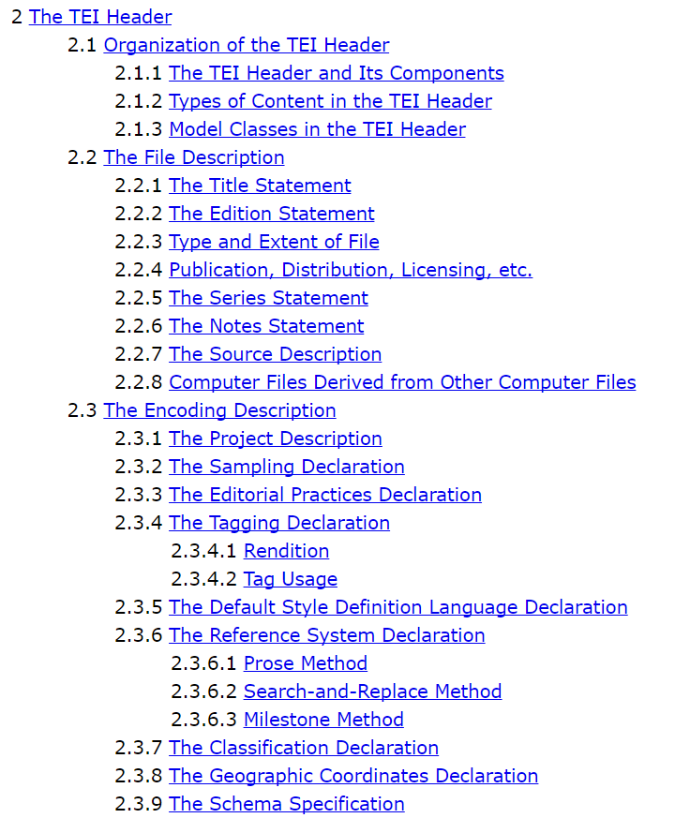
Chapters / modules

Slide 13
The TEI ecosystem
TEI Consortium (Technical Council, Board of Directors)
Open source and collaborative development
Guidelines and web pages regularly maintained
A friendly and active tei-l mailing list
jTEI journal and annual conferences of the TEI
Support tools:
Roma: Web interface to parametrise TEI and generate XML schema
TEI Stylesheets: conversion to and from TEI for many formats (docx, open office, html, markdown, ePub, …)

Slide 14
TEI in Slovenia (1998-)
Reference corpora: Fida, FidaPLUS, Gigafida; ssj500k; hr500k, …
EU projects (IJS et al.): MULTEXT-East, IMPACT, ELEXIS
National projects ZRC SAZU + IJS: Scholarly editions of Slovenian literature, Slovenian biography
Projects with UL Dept. for Asian languages + IJS: Japanese-Slovene learners’ dictionary and corpora
DARIAH-SI + CLARIN.SI: digital library + corpora (e.g. siParl)
National projects IJS:
JOS: Linguistic Annotation of Slovene
Janes: Linguistic Annotation of Non-Standard Slovene
KAS: Slovene Scientific Texts: Resources and Description

Slide 15
Examples of TEI use: “1984”

Slide 16
Izidor Cankar: S poti

Slide 17
Slovene biography: on the web

Slide 18
Slovene biography: TEI

Slide 19
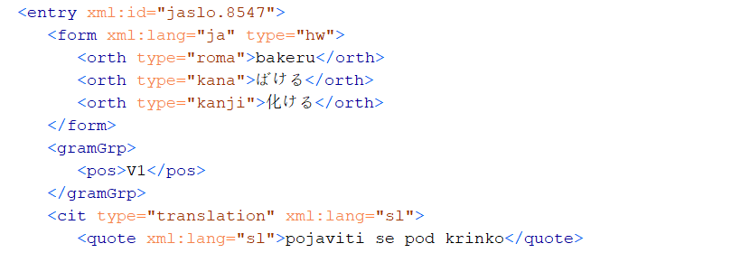
jaSlo: Japanese-Slovene dictionary

Slide 20
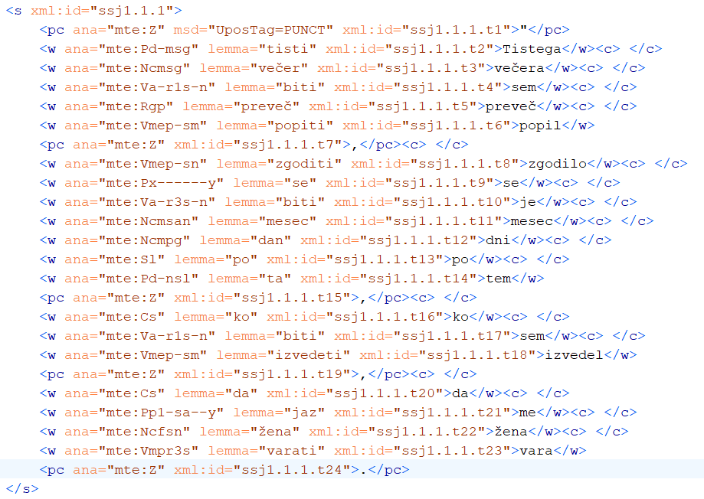
ssj500k v2.2: training corpus

Slide 21
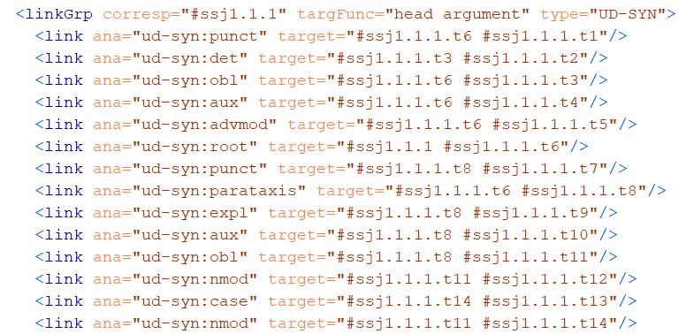
ssj500k v2.2: syntax

Slide 22
goo300k: Historical Slovene

Slide 23
Parla-CLARIN and siParl 2.0
Parliamentary data: openly available and very useful for a number of disciplines
Many countries have already made available corpora of parliamentary debates, but each one encoded differently
CLARIN organised several events and initiatives to promote and study parliamentary corpora (PC)
In 2019 CLARIN also organised a workshop and financed work to develop a common encoding schema for PCs
Cooperation between DARIAH-SI (Andrej Pančur) and CLARIN.SI (Tomaž Erjavec):
TEI based Parla-CLARIN schema
siParl 2.0: first corpus encoded in Parla-CLARIN

Slide 24
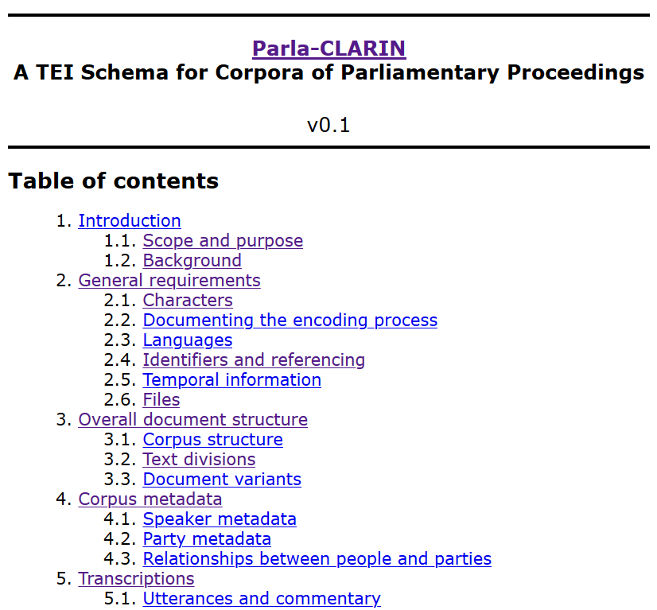
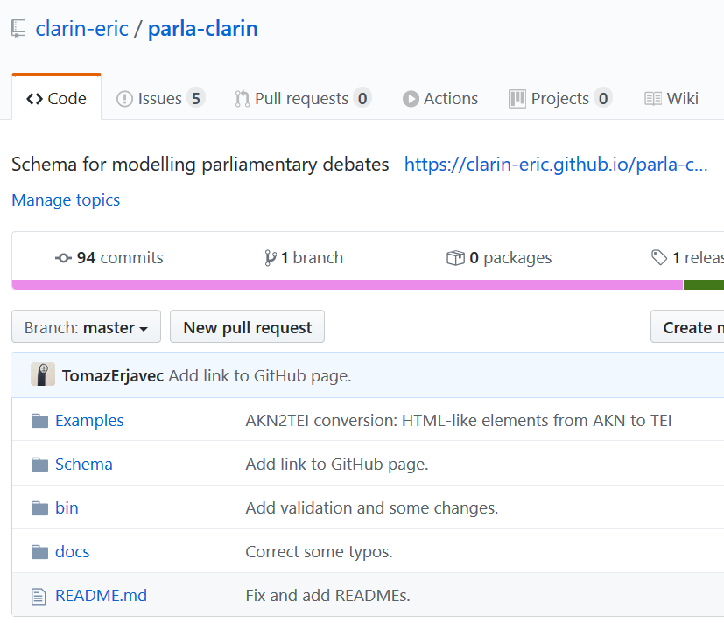
Parla-CLARIN
TEI based Parla-CLARIN schema: https://github.com/clarin-eric/parla-clarin
ODD document + XML schema + example folders
Readable documentation in HTML: https://clarin-eric.github.io/parla-clarin/

Slide 25
siParl 2.0
First corpus encoded in Parla-CLARIN http://hdl.handle.net/11356/1300
Slovene parliament 1990-2018
Speaker meta-data
Mandates, Parties, Committees, …
Speeches
CLARIN.SI version: linguistic annotation
Available in the repository and through CLARIN.SI concordancers

Slide 26
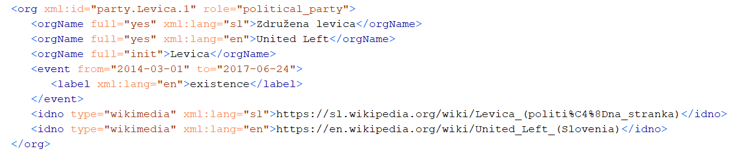
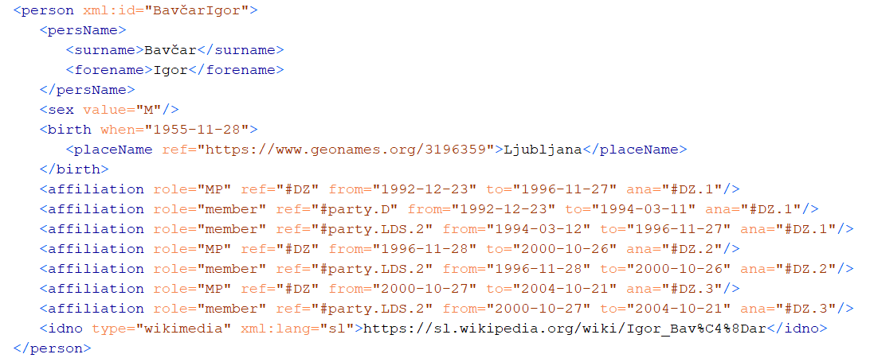
siParl 2.0: metadata

Slide 27
siParl: speeches

Slide 28
Conclusions
TEI is a large collections of elements and attributes for annotating various types of texts and their analyses
Documented, maintained, with lots of support tools and a large user community
Relatively popular in Slovenia in Digital Humanities, Corpus and Computational Linguistics
Many CC TEI language resources (with down-conversions) are available in the CLARIN.SI repository

