Slide 1
The CLARIN.SI repository
Tomaž Erjavec
Department of Knowledge Technologies, Jožef Stefan Institute
FRI, 29th April, 2020

Slide 2
Repository
Currently the most important service of CLARIN.SI
Long-term and safe archiving of language resources (https, Nagios)
Explicit terms of use (terms of service, licence)
Ethical codex (Code of conduct)
Most resources in standard encoding (Unicode, XML)
Certified as CLARIN Centre B
Digital Seal of Approval, DSA
Currently being (re)certified for Core Trust Seal, CTS

Slide 3
Repository platform
Based on the DSpace platform, developed for open digital repositories
DSpace modified for use by CLARIN repositories: CLARIN/DSpace developed by Czech CLARIN
Used by Czech, Italian, Norwegian, Polish, and Slovenian CLARIN
Maintenance on GitHub, Slovenian fork on GitLab

Slide 4
Metadata
Standard encoding of metadata:
Component Metadata Infrastructure (CMDI)
Dublin Core (DC)
Metadata always CC0
Meta-data harvesting:
CLARIN Virtual Language Observatory (VLO)
also:

Slide 5
Permanent identifiers
Each repository entry is assigned a PID
So, even if the repository platform is changed, the PIDs stay the same (but need to be reconfigured)
Best known solution: DOI
CLARIN used the Handle system
http://hdl.handle.net/11356/1044 → https://www.clarin.si/repository/xmlui/handle/11356/1044
Important for citation of repository items:

Slide 6
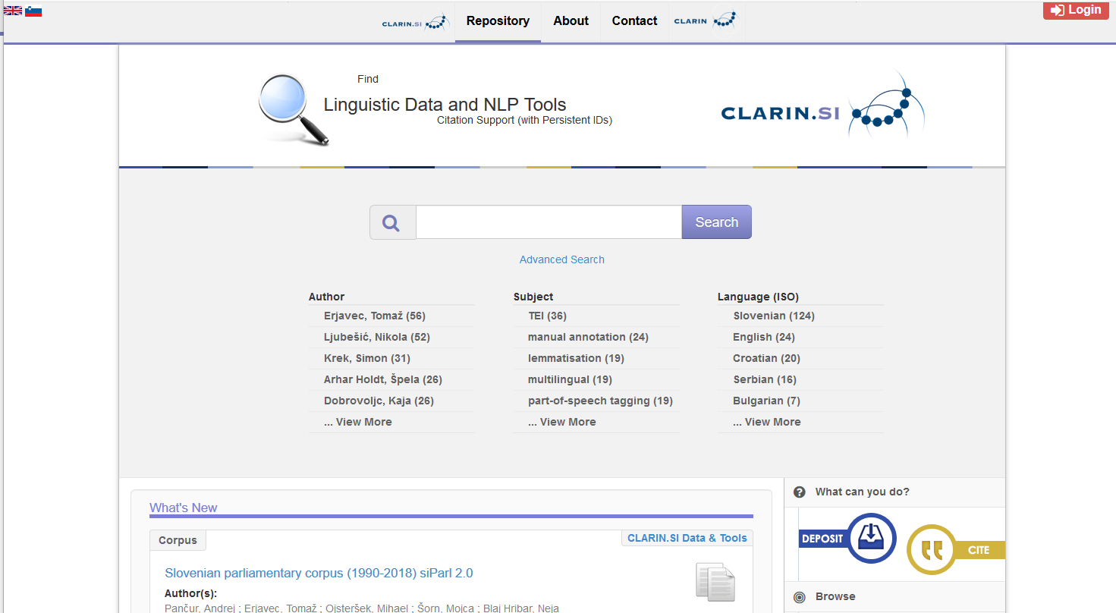
Top level page

Slide 7
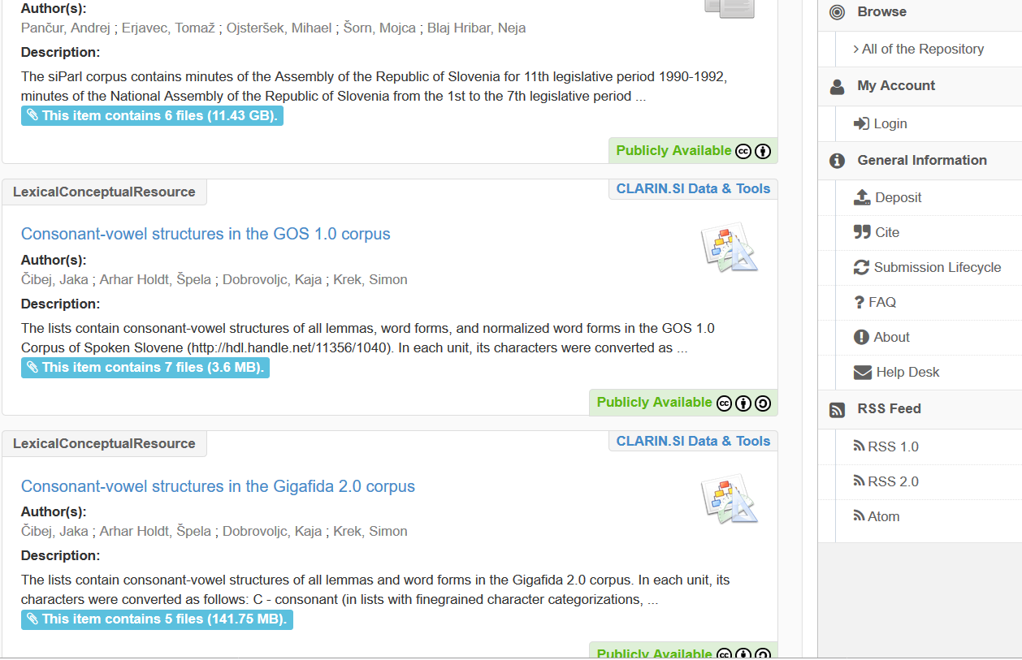
Top level page

Slide 8
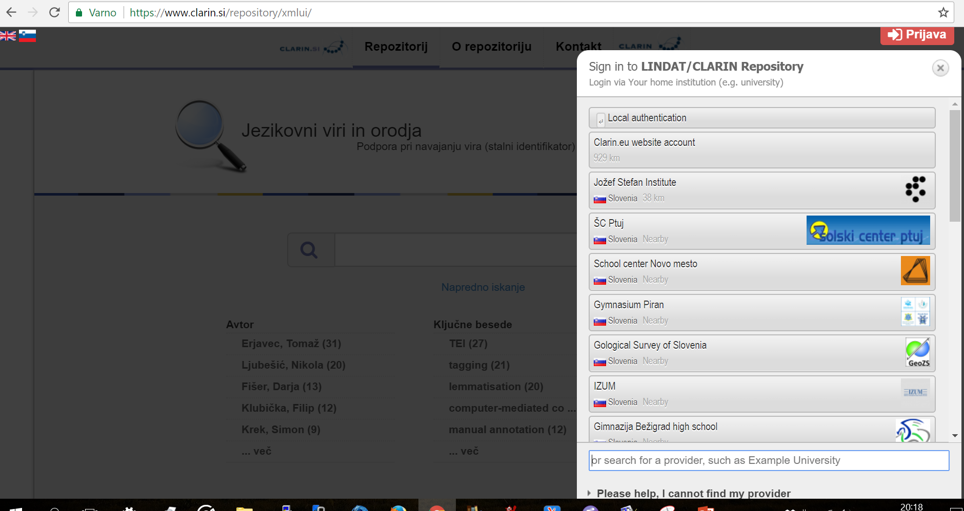
Log-in
Necessary for making a new repository item, for accessing non-CC items and for using some advanced functions
For those without EduGain, CLARIN ERIC also gives accounts

Slide 9
How to find interesting resources
Browsing by language, type of resource, keywords, author, etc.
Search (fuzzy matching)
Advanced facet search
Currently 163 items (without prior versions)

Slide 10
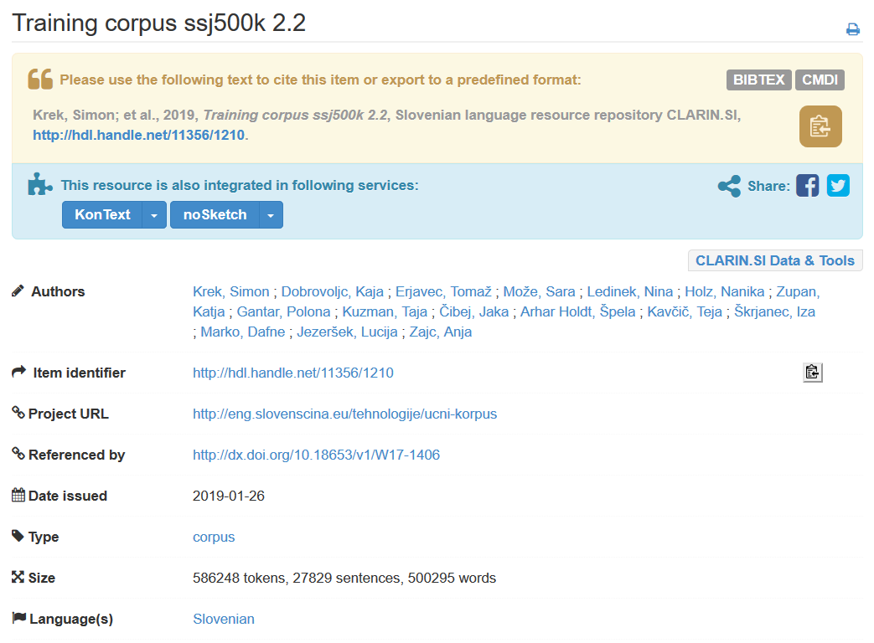
Landing page of a repository item 1.

Slide 11
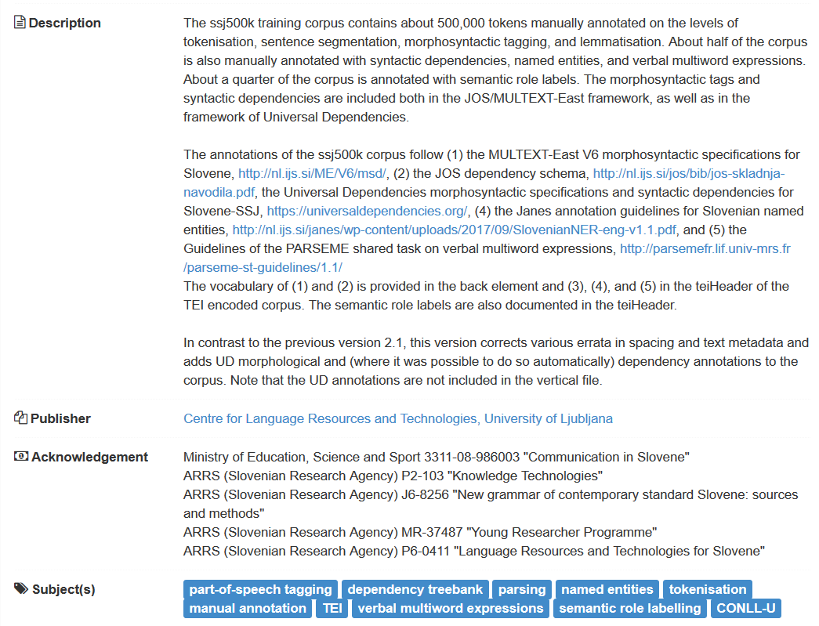
Landing page of a repository item 2

Slide 12
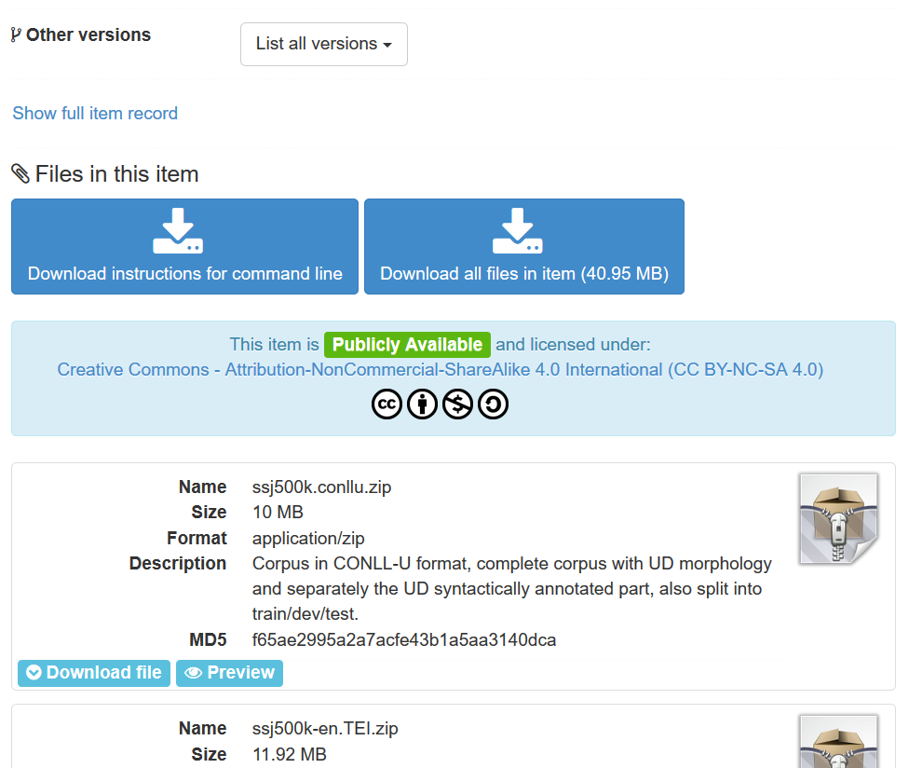
Landing page of a repository item 3

Slide 13
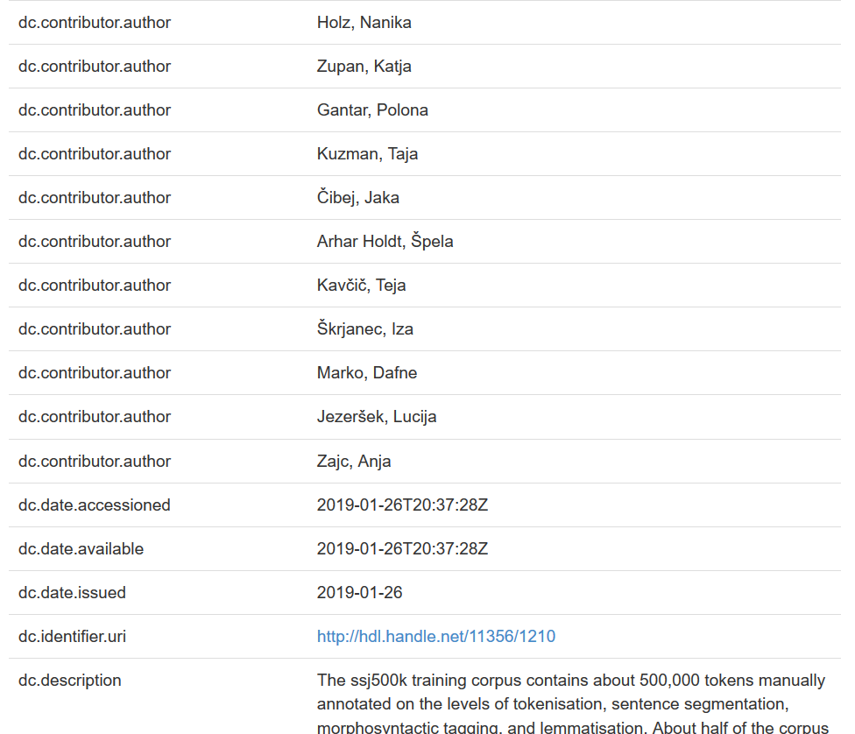
DC metadata

Slide 14
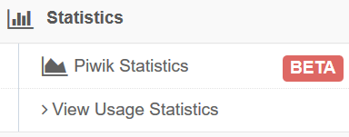
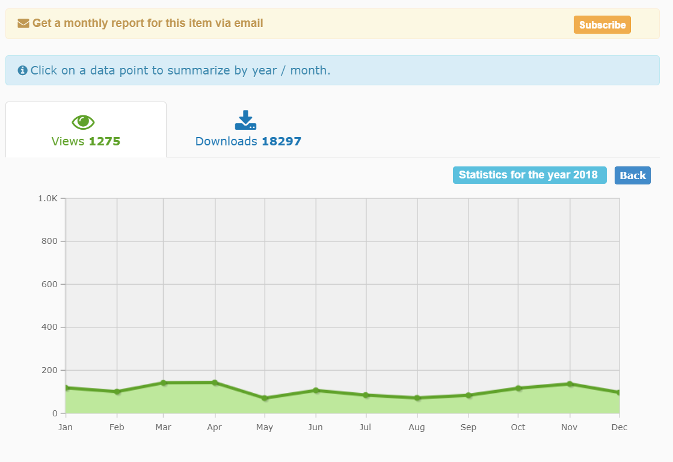
Piwik

Slide 15
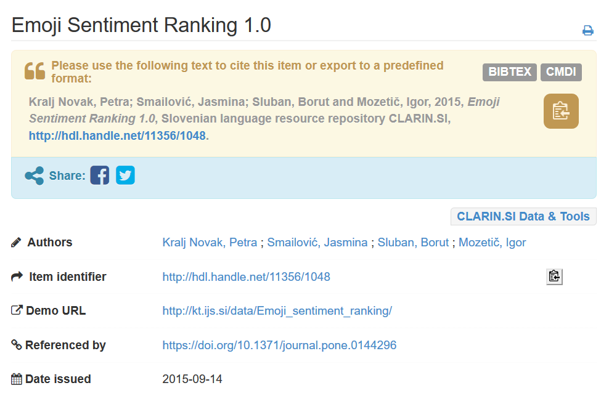
Repository: download
Most entries available under Creative Commons licences
Others: AAI login, agree to licence conditions: CLARIN.SI Licence ACA ID-BY-NC-INF-NORED
Cite the resource!
Always use the handle, not the URL!

Slide 16
Repository: deposit
AAI log-in
Fairly simple workflow:
However: follow best practices, look at other entries!
Choosing the licence
Possibility to embargo the data
Can enter a new version of a resource
Option to share item editing
The entry is checked by one of the CLARIN.SI editors

Slide 17
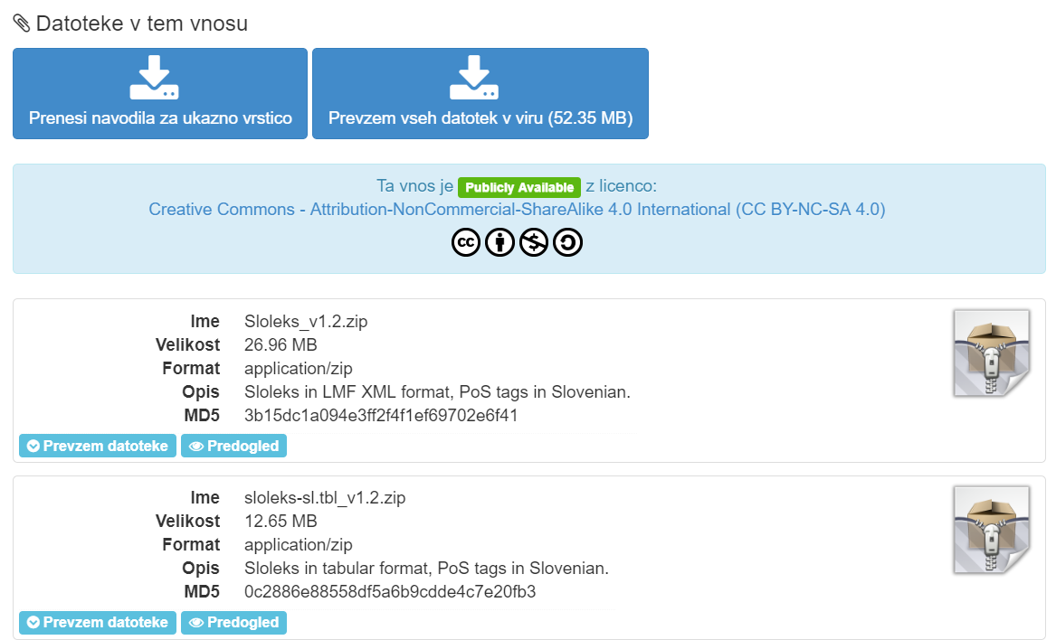
Data Formats
Media files: wav, avi, jpg, png…
Data with tabular structure: TSV, CSV, XML
Hierarchical data: XML
using one of the „standard“ schemas, e.g. TEI, …, TRS, ELAN
using your own schema
in all cases: schema + documentation must be part of the entry
+ Derived formats + Documentation (can be PDF)
Deposit as ZIP

Slide 18
What is in the repository?
Language models, training data, lexicons for tagging, lemmatisation, syntax of Slovene, Croatian, Serbian, for standard and non-standard language
Various types of word embeddings
Large annotated corpora of various text types
Speech corpora
Multilingual corpora
Machine readable dictionaries
Some software

Slide 19
Tools
“Language models, training data, lexicons for tagging, lemmatisation, syntax of Slovene, Croatian, Serbian, for standard and non-standard language”
tokenisers, morphosyntactic taggers for sl, hbs
parsers (also UD-PIPE)
Viewers and editors for linguistic annotation

Slide 20
CLARINSI@GitHub

