Slide 1
The CLARIN.SI research infrastructure
Tomaž Erjavec
Department of Knowledge Technologies, Jožef Stefan Institute
FRI, 29th April, 2020

Slide 2
Overview of the lecture
Introduction
The CLARIN EU research infrastructure
The CLARIN.SI research infrastructure
CLARIN.SI services

Slide 3
I. Introduction
Language technologies
main paradigm: supervised machine learning
programs are mostly language independent
need training (manually annotated) language resources
+ test data
Empirically supported linguistic investigations:
based on real (and, if possible, annotated) language data
Annotated language resources are necessary for each language
Where can we get such resources for Slovene (and other South-Slavic languages)?

Slide 4
Language resources
Corpora:
uniformly encoded and document collection of texts
explicit criteria for text selection
annotated (morphosyntax, lemmatisation, syntax, named entities, …)
reference/specialised; mono/multilingual; text/speech
Lexicons:
the vocabulary of a language
words / phrases
morphosyntax, syntax, semantics, translations, external and internal links
Models:
data that enables a program to annotate text in a certain language for a certain level of annotation
e.g. Stanford-NLP model for parsing of Slovene; Moses model translating Slovene to English

Slide 5
Resource reuse
Traditional approach:
develop language resources for each project separately
resources unavailable to other researchers
Disadvantages:
the development of a language resource can be very costly: waste of time and money if it is done several times
later researchers cannot replicate or improve the initial results
supports the monopoly of institutions that produced the resources
the resources cannot be used to help in the development of products

Slide 6
Open access to the results of research projects
No barriers to publications and data:
saves of time and money;
avoids repetition of work;
encourages cooperation;
makes the research process more transparent
stimulates innovation
A very strong trend in EU (H2020) projects, also in Slovenia
Problems in enabling open access to language resources:
copyright on texts
privacy protection (GDPR), including the right to be forgotten,
terms-of-use by owners of social media platforms (e.g. Twitter)

Slide 7
Research infrastructures
Research Infrastructures are facilities that provide resources and services for research communities to conduct research and foster innovation.

Slide 8
Research infrastructures
Beginning, 2002: ESFRI (European Strategy Forum on Research Infrastructures),
Roadmap: proposed 15 (2016: 21) RIs, some already established as ERICs (EU legal entity: European RI Consortium)
Slovenia participates in 14 RI (e.g. CERN, ELEXIR)
Humanities and Social Sciences:
DARIAH ERIC / DARIAH-SI: Digital Research Infrastructure for the Arts and Humanities
CLARIN ERIC / CLARIN.SI: Common Language Resources and Technology Infrastructure
Social Sciences: CESSDA / ADP, Arhiv družboslovnih podatkov

Slide 9
II. CLARIN ERIC
Common Language Resources and Technology Infrastructure

Slide 10
Common Language Resources and Technology Infrastructure
Vision: digital language resources and technologies for all (European) languages are available for researchers in the humanities and social sciences
Repository for long-term, extensive archiving and enabling access to language resources and technologies
Contribution to preserving and supporting the European multilingual cultural heritage
A collaborative paradigm in the compilation of language resources and the development of language tools, enabling re-use, experiment replicability and reproducibility

Slide 11
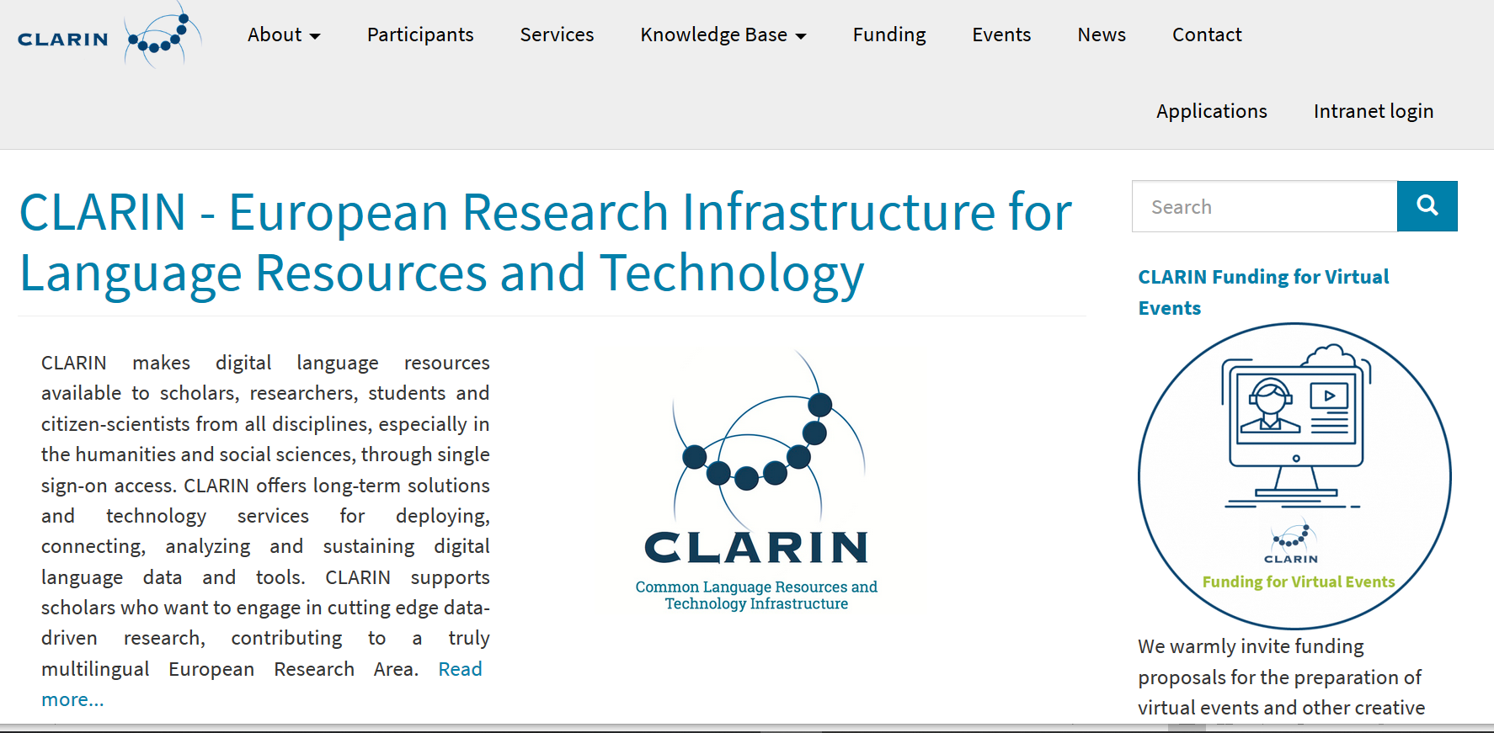
Enable access to existing solutions in a unified infrastructure
Consulting & teaching how to adapt tools and resources to specific research needs
Legal, technical aspects of distribution
Contribution to standardisation of resources and tools

Slide 12
CLARIN ERIC
21 member states + 4 observers
Based in the Netherlands: director, support staff, strong DH / CL community
Committees: BoD, NCF, SCTC, …
Aggregators: Virtual Language Observatory
Most work is done by the national consortia
Annual conference:
authors of accepted paper go for free
session for PhD students
book of abstracts (post-conference papers), posters, bazaar, invited talks etc.

Slide 13
III. CLARIN.SI

Slide 14
CLARIN Slovenia, start of work in 2014
Organised as a consortium of (currently) 11 partners:
4 universities: Ljubljana, Maribor, Nova Gorica, Primorska
4 research institutes: ZRC SAZU, IJS, INZ, Trojina
2 companies: Amebis, Alpineon
1 society: Slovenian society for language technologies, SDJT
Headquarters at IJS:
E8: Dept. for Knowledge Technologies
E3: Laboratory for Artificial Intelligence
CMI: Networking Infrastructure Centre<

Slide 15
Repository
Long term archiving of language resources (and tools)
Also, for software and manually annotated datasets: CLARINSI GitHub virtual organisation & http://gitlab.clarin.si
Web services:
2 concordancers (corpus analysis)
automatic annotation
WebAnno platform for manual annotation (e.g. training sets)
Support for events:
Conference „Language Technologies and digital humanities“ (1998, …, 2016, 2018, 2020)
JOTA lectures “Jezikovnotehnološki abonma”: VideoLectures
XVIII EURALEX International Congress, Ljubljana, 2018
22nd Intl. Conf. on Text Speech and Dialogue, Ljubljana, 2019
Support for development and archiving language resources and tools
support for resource update for archiving in the repository (cca 500 EUR)
larger projects for development: 2018: 8, 2019: 7 projects (cca 6,000 EUR)

Slide 16
CLASSLA K-Centre
CLARIN certified knowledge centre for Processing of South Slavic languages
CLARIN.SI + Bulgarian CLARIN
FAQ on processing Slovenian, Croatian, Serbian, Bulgarian
CLASSLA automatic annotation web service
CLARIN.SI repository offers the most resources for Croatian and Serbian
CLARINSI@GitHub offers many tools to process Slovenian, Croatian and Serbian (HBS)

Slide 17
CLARIN.SI Cooperation
CLARIN: National coordinators forum, Working Groups on Standards, Legal Issues, User Involvement, Technical Centres
DARIAH-SI (INZ): joint development of corpora: digital library + linguistically analysed corpus (e.g. siParl)
ADP/CESSDA (FDV): RDA Node Slovenia

Slide 18
IV. CLARIN.SI Services
AAI Log-in
Concordancers
WebAnno
ReLDI annotation
Repository and Git (next lecture)

Slide 19
Log-in
Infrastructure for authentication and authorisation (AAI)
Single Sign-On: separation between the Identity Provider and Service Provider
As opposed to standard web login we here know the identity of the user
Identity provider federations: EduGain
Slovene users can, via EduGain, access most CLARIN services in Europe

Slide 20
Concordancers
KonText + noSketch Engine
both use the same back-end: Manatee
support large corpora (> billion words)
corpora can have rich annotations:
structures (text, speech, sentence, etc.)
meta-data (publication date, text type, author name, text standardness, etc.)
token attributes (PoS tag, lemma, normalised form, etc.)
powerful query language: CQL
various types of analysis and output
RESTFUL interface: usable via API
CLARIN.SI concordancers offer ~100 corpora

Slide 21
KonText (CLARIN-CZ)

Slide 22
Concordances

Slide 23
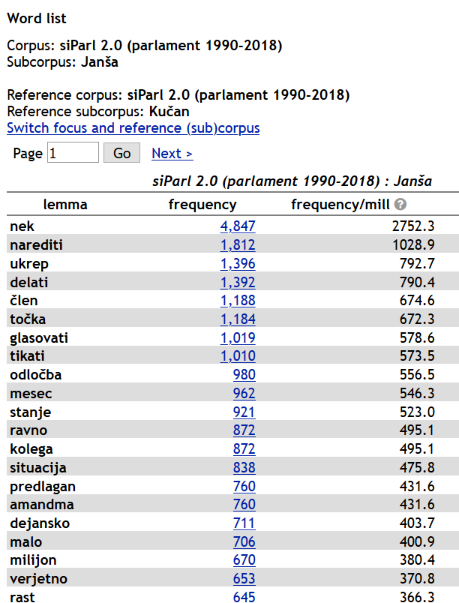
Kučan vs. Janša

Slide 24
WebAnno (CLARIN-DE)

Slide 25
ReLDI automatic text annotation
Web form
API

Slide 26
Result

Slide 27
V. Conclusions
The purpose of CLARIN(.SI) is to support research that need access to language data
Digital humanities and social sciences
Language Technologies (~ Computational Linguistics)
All other fields where language is important
Open access to resources, tools and services
Where authentication is needed, AAI is used
CLARIN(.SI) financial support:
Organising various types of events
Work on specific topics incl. outreach
Development or modification of resources
Attendance at CLARIN conferences

